Slide 1
Analysis of Amazon sales
2010-2017
Year wise trends | current year (2017) KPIs | profits, revenues, costs
| profitable items | promising regions | lead time analysis

Slide 2
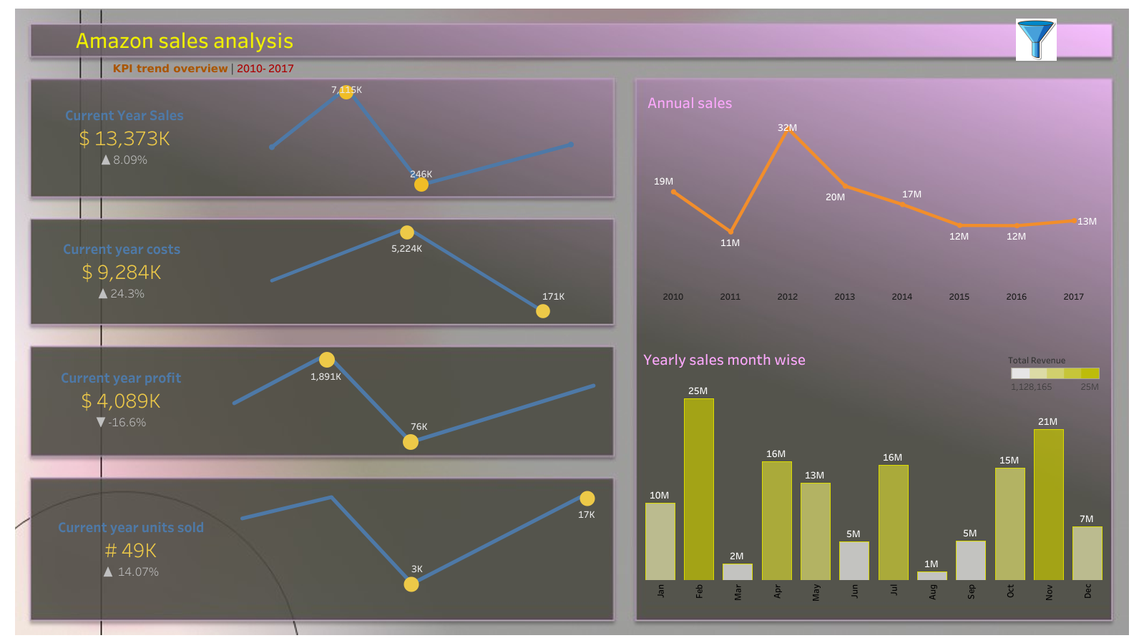

Slide 3
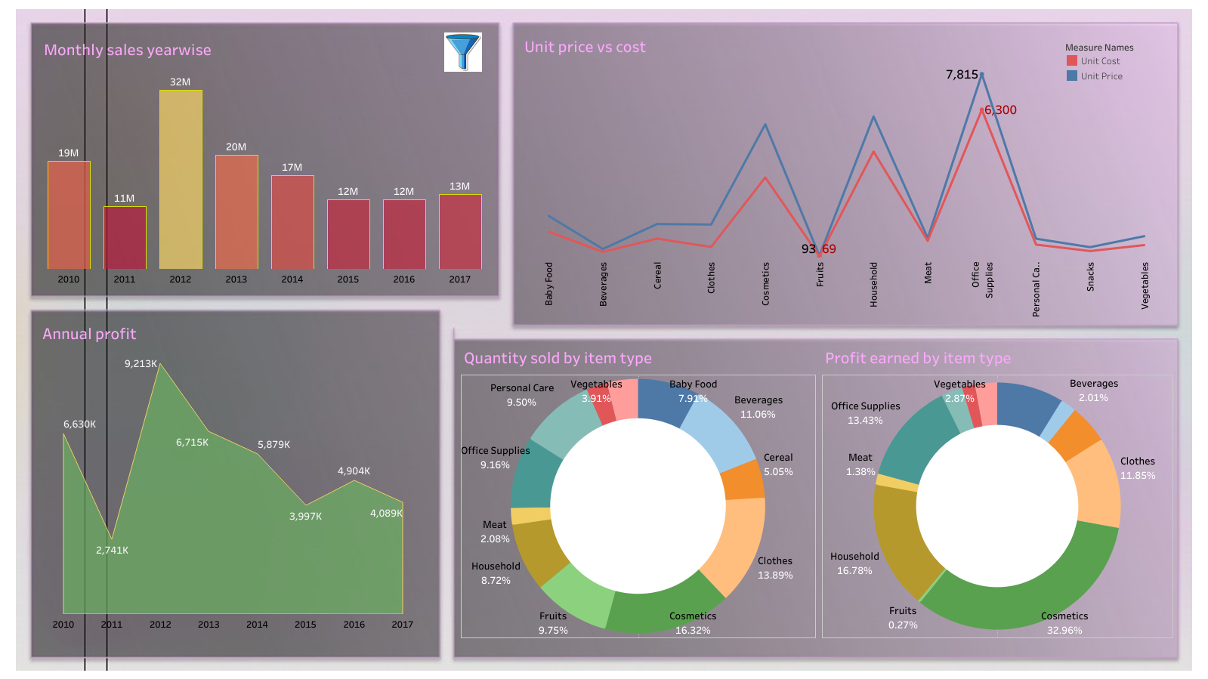

Slide 4
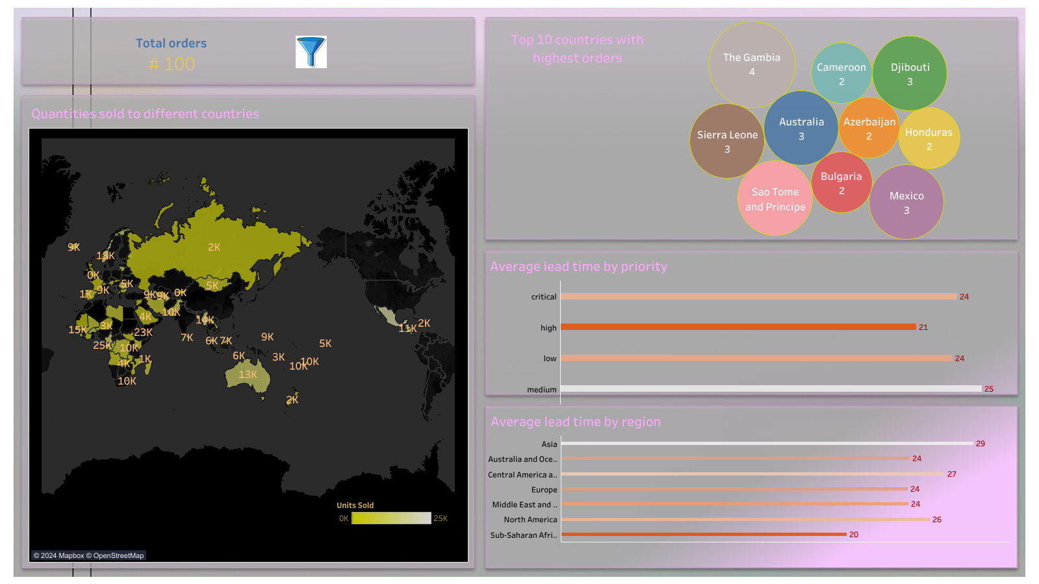

Slide 5
Key insights
The highest sales made by the co. was in 2012 ($32 m.) with the latest growth rate being a positive 8.09%.
Profit has recorded a negative growth rate of 16.6%. The highest profit was a staggering $9213 K in 2012.
The highest cost ($6300) and hence price ($7815) owe to office supplies, rendering a profit of $1515 per unit sold.
The most sold item is cosmetics (16%) which is also the most profitable item (33%) followed by office supplies (13%). More focus to be given in these two and other promising items to expand overall profit.
The least profit is accorded to fruits (0.26%) despite greater share of units sold (9.75%). This makes sense given the establishment of competent rivals like blinkit, zepto, instamart who are better equipped for this business.
Total no. of orders in these regions account for 100. Australia and Norway– 13K have given most no. of orders. These are the target customers.
Lead time (days btw order processing and shipping) on an average is the highest for medium priority orders (25 d.) and lowest for high priority orders (21 d.). Time for critical orders should come down further from 24 d.

Slide 6
Thank You

